Slide 1
Effect of Minimum Wages on Employment & Crime profile
A study for the United States
Team: Sneha Kumari, Polina Zasheva, and Will Payne

Slide 2
Motivation and Summary:
The debate about the effect increases in the minimum wage have on employment is ongoing.
Some studies find either no or only a small effect while others find significant effects
A study recently published in the American Economic Association provides new evidence that increases in minimum wage reduces employment in the long run.
(click here for review)
The goal of this research is to review 8 years of historic data across the entire United States and come up with our own understanding of the impacts of minimum wage on the overall economic profile of our country.

Slide 3
Questions Guiding Our Research
Is there a relationship between unemployment and crime?
Does that relationship vary by state, region, or is it consistent across the entire United States
Understand the trends in Minimum wage , Crime and Unemployment for the time frame of our dataset
Did changes in minimum wage impact employment and subsequently crime?
As demonstrated through the remaining of this presentation, we were able to successfully answer each of our preliminary questions and develop a good understanding of the US’ economic profile in examined time period

Slide 4
Hypothesis
We are set out to test three related hypotheses regarding the United States economy:
Minimum wage and unemployment rate relation:
H1 : Higher minimum wage has the potential to increase unemployment rates over time
H0 : Minimum wages do not have any effect on unemployment rates
Minimum wage effect on CPI index:
H1 : Higher minimum wage has short term positive impact on CPI which eventually levels off as unemployment rises
H0 : Minimum wages do not have any effect on CPI index
Unemployment and Crime Rates:
H1 : Because of increased unemployment, crime rates will also go up over time
H0 : Minimum wages do not have any effect on CPI index
Our assumptions are based on a number of academic publications describing impact of minimum on the economy (click here for bibliography)

Slide 5
Data and Methodology:
We found data on Minimum Wage, Consumer Price Index, and Unemployment over 8 years (2009 - 2017) and across all 50 states. The crime data was available till 2014.
Data Sources:
Kaggle: US Minimum Wage By State
National Conference of State Legislatures: State Unemployment Rates
Uniform Crime Reporting Statistics (Sourced by FBI)
Using Jupyter Notebook and imported libraries such as ‘Pandas’, ‘Numpy’ and ‘MatPlotLib’ we cleaned and merged the data together to analyze the output and prepared the visualizations used throughout this presentation

Slide 6
Brief Summary of Findings
Overall, as unemployment decreases, we see a decrease in crime rates across all states
2014 demonstrates the biggest drop in unemployment rates which is consistent with the tail end of the great recession from 2009
In the same period of time, 2009 – 2014, crime rates were consistent (slightly downward trending) but in 2014 there is a noticeable drop in crime which is consistent with the drop in the average unemployment index
In general, Crime and Unemployment move in the same direction though not proportionally which leads us to believe that though the two events may happen simultaneously, there is more than one factor that drive crime rates – this is especially evident as we break up our data at a more granular level (by state).
In the short term, increases in minimum wage did not drive unemployment and seemed to lower crime rates especially in areas with historically high crime.

Slide 7
Data Cleanup & Exploration
The data was available in CSV and Excel but it wasn’t consistently formatted as it came from multiple sources
Unemployment Rate Data - monthly and each year was in a separate file. We had to find the avg. UI per state and merge each year using Jupyter Notebook. We then dropped the monthly figures as the rest of our data was yearly
Crime Rate Data – crime data came in multiple tables for each state. All the tables were in same sheet. We cleaned up the formatting, dropped unnecessary data fields, cleaned null values, and merged everything in one large file using Jupyter Notebook
Minimum Wage Data – the minimum wage data from Kaggle was the cleanest but spread across 50 years. We removed unnecessary fields, extra years, cleaned null values, and merged with the rest of our data sources using Jupyter Notebook
Other – not all states/ areas were name consistently (for example, DC was spelled D.C., DC, District of Columbia). We streamlined the naming convention across all states.

Slide 8
Unanticipated Findings
By state, we expected to see that states which stood out as having higher than average unemployment rates would also see high crime instances.
We found that not to be the case at the individual state level but rather on the aggregate (across the country).
In other words, on average, as unemployment rises, so does crime, however that is not consistent in state by state comparisons.
A t-test will confirm if there is sufficient correlation to prove the hypothesis.
States with historically high crime rates see bigger drops in crime as unemployment decreases compared to states with historically lower crime rates. This could indicate that there are other (potentially more impactful) factors on crime than unemployment.
Within the 8 year time frame we studied, increases in minimum wage did not seem to have an adverse (negative) effect on unemployment. Unemployment dropped noticeably and consistently YOY while minimum wage rates remained the same and increased slightly

Slide 9
Data Analysis and results

Slide 10
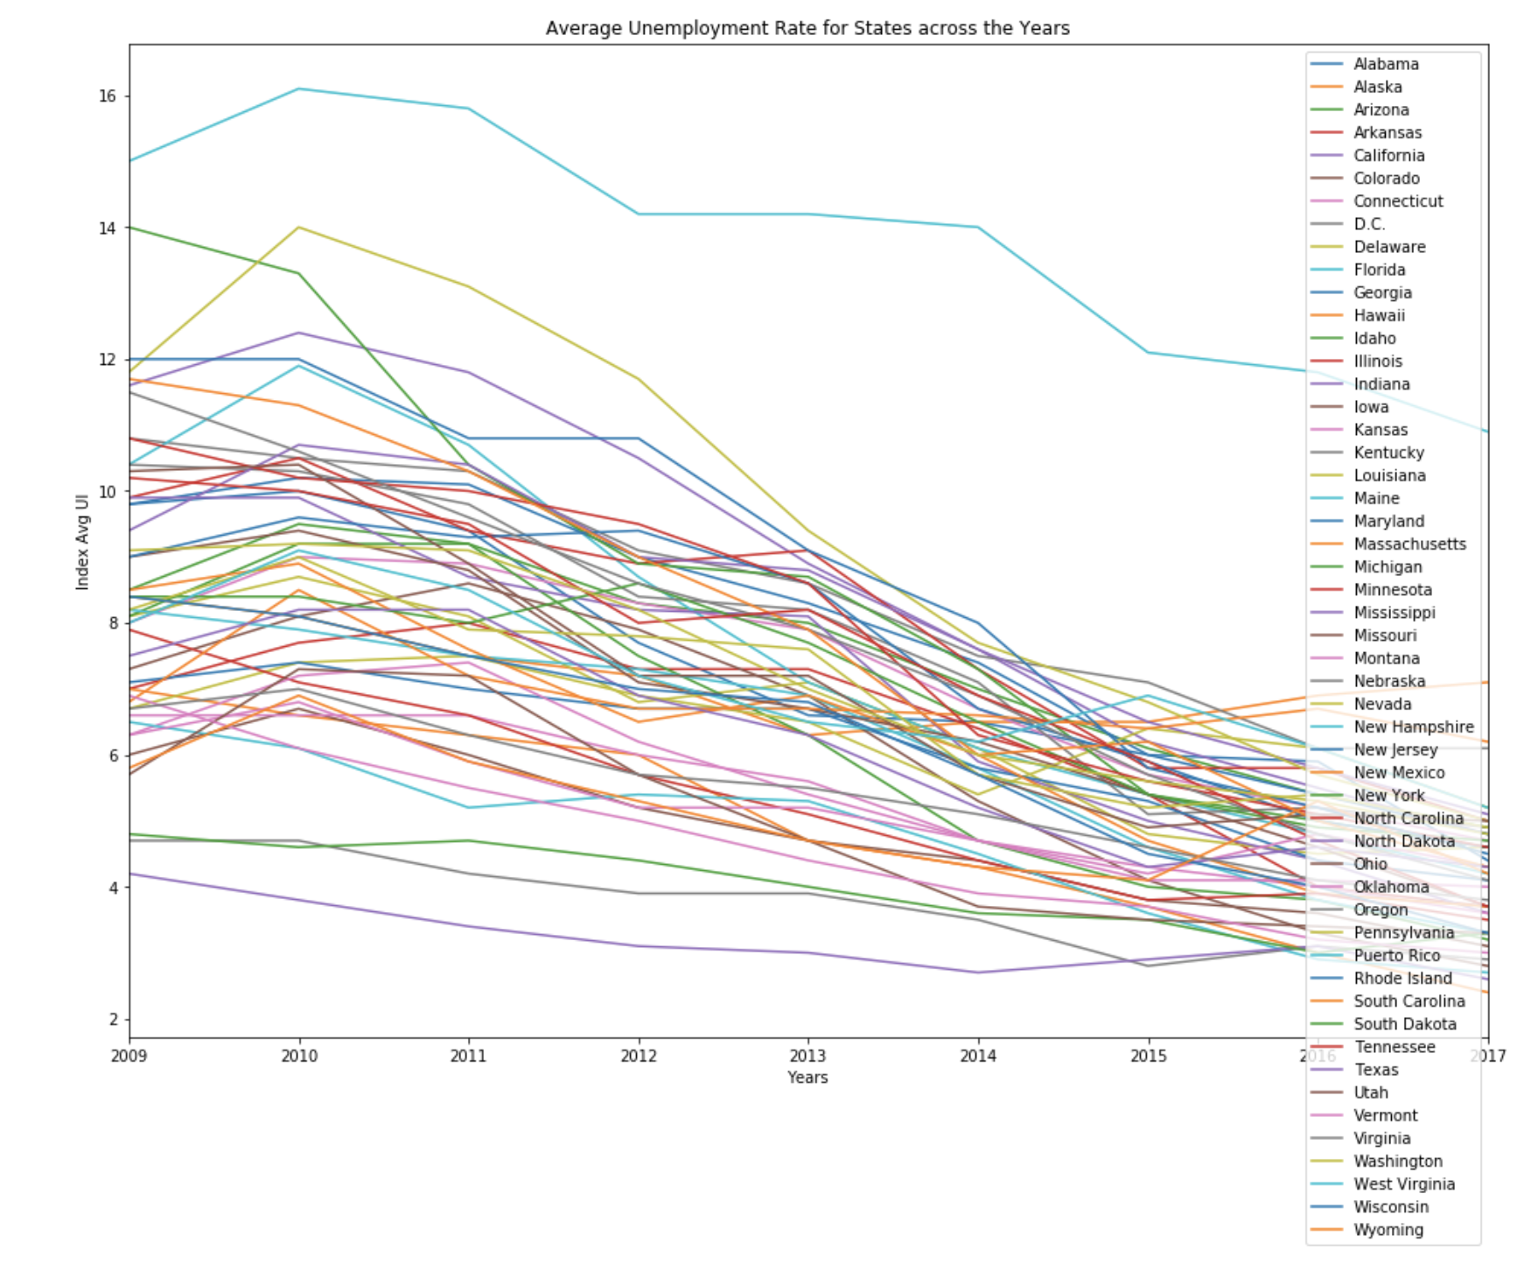
Unemployment Rates for States
Overall, between 2009 and 2017, average unemployment decreased significantly, through in some states, such as Puerto Rico, it remined noticeably higher than the national trend

Slide 11
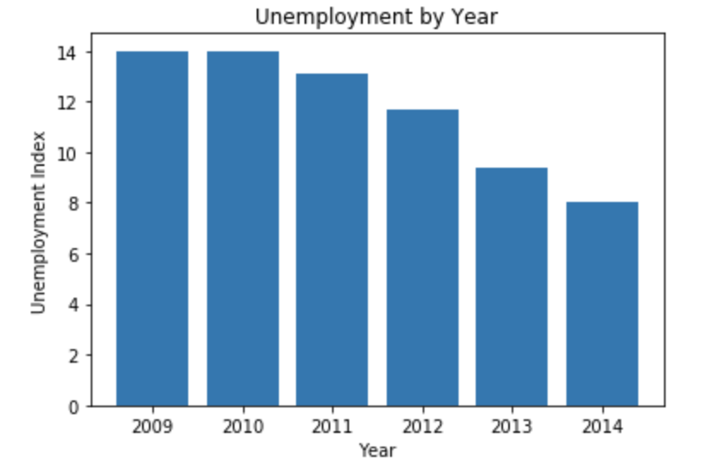
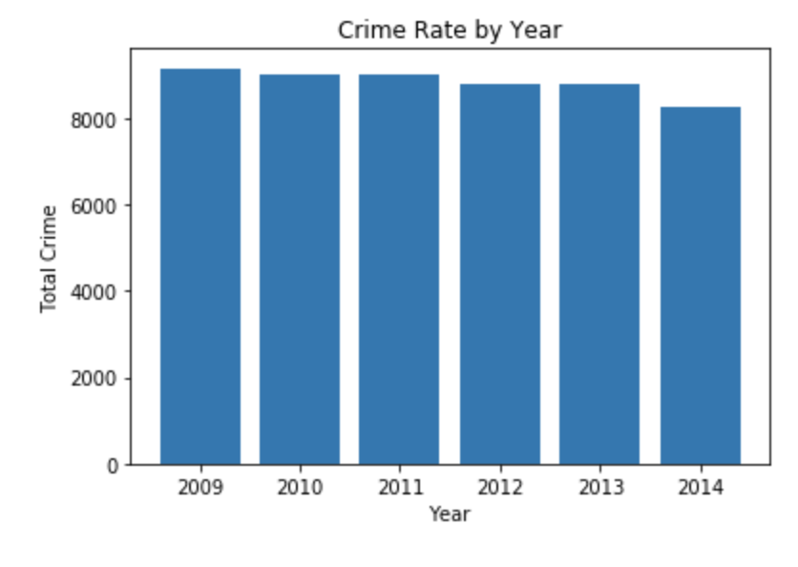
Yearly Trends
Notes:
By year, crime rates remained consistent with a very slight decline YOY and a bigger decline in 2014.
That’s consistent with the decline in Unemployment Rates YOY, when in 2014 we saw the largest decline in the UI.
These findings are consistent with our initial hypotheses that unemployment and crime move in the same general direction

Slide 12
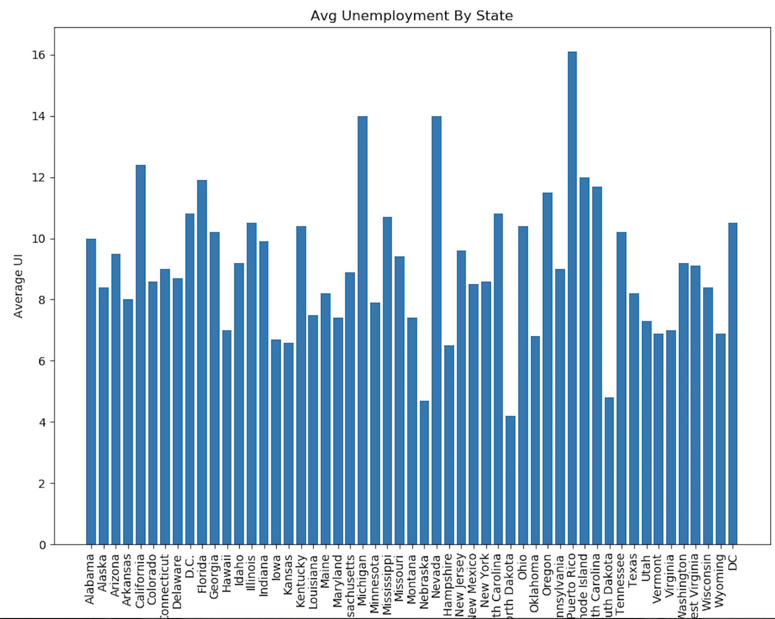
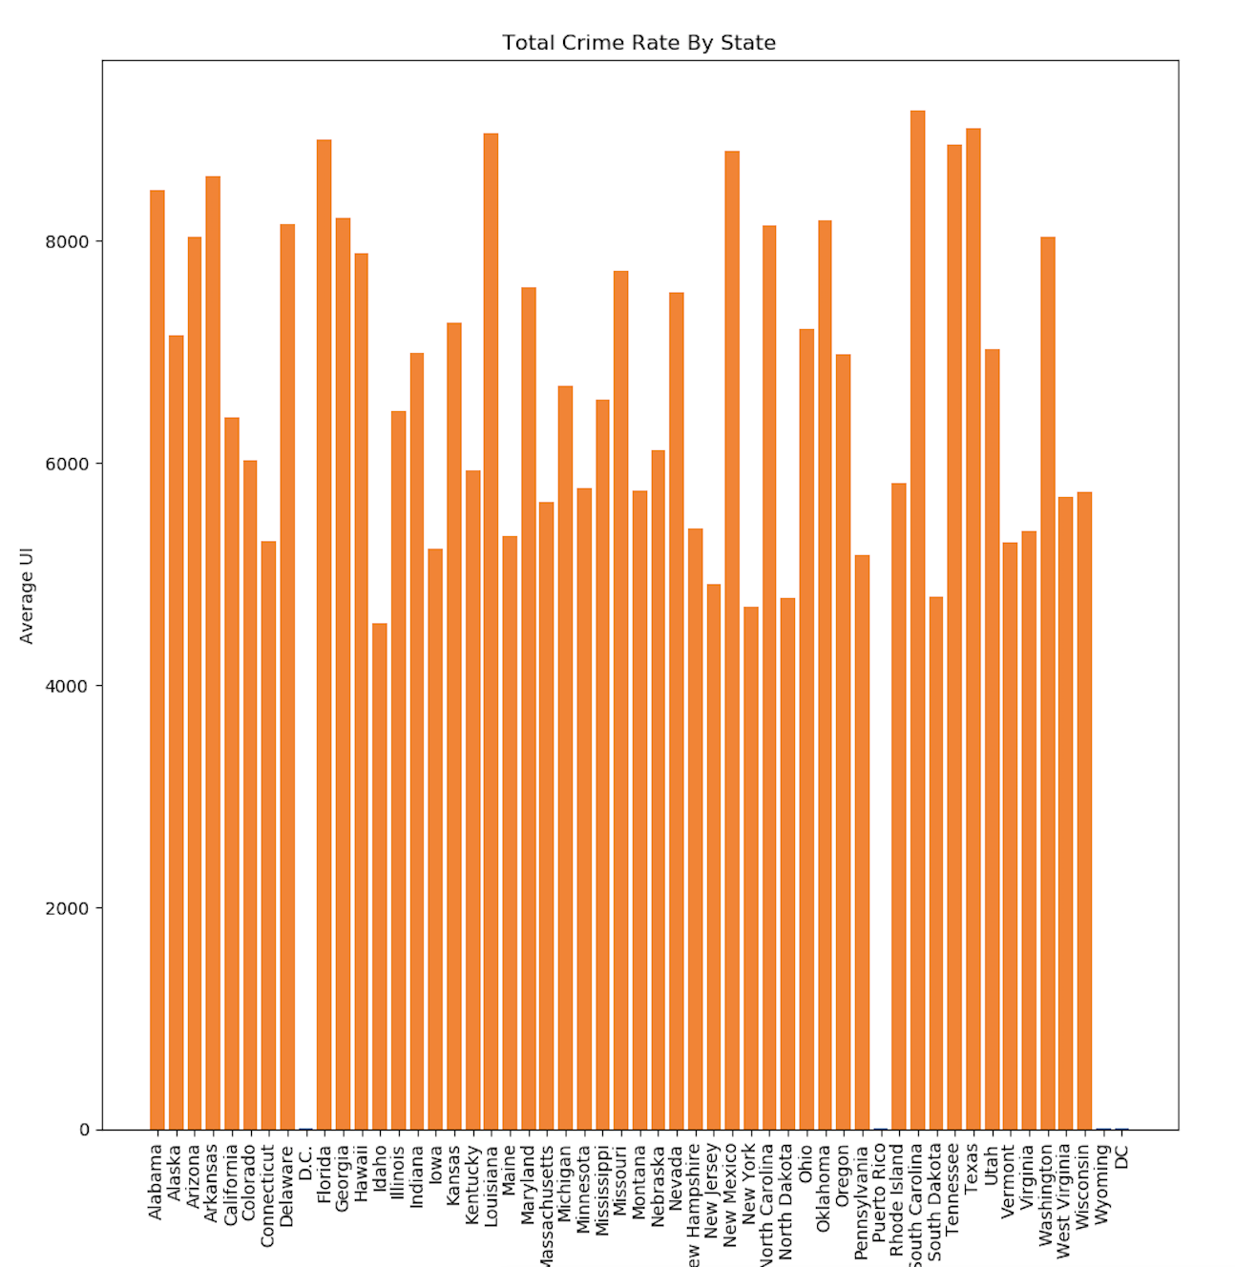
Unemployment and Crime by State
Some of the states with highest unemployment rates between 2009 and 2014 are Nevada, Michigan, California
Those states don’t particularly stand out as having the highest Crime Rates.

Slide 13
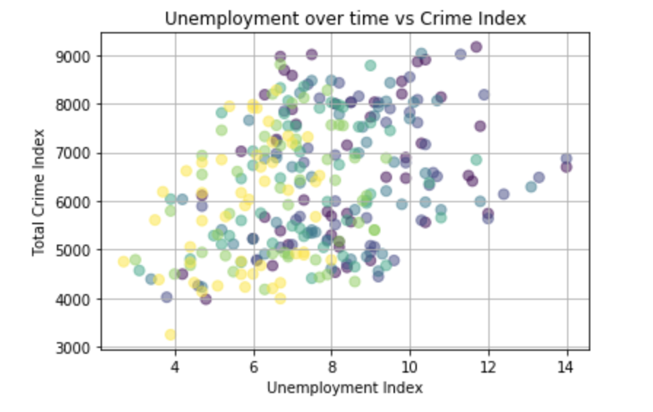
Unemployment & Crime by Year
Unemployment across the US to the Total Crime Index shows a generally positive relationship.
The color coding below represents each year in our data
Notes:
That trend is consistent across all years we explored – 2009 to 2014.

Slide 14
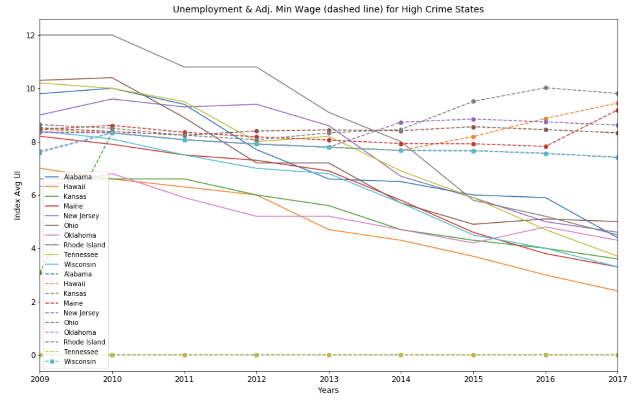
Grouped Data – High Crime States
States with historically high crime rates experience high drop in crime for small decreases in unemployment compared to states with more moderate and low levels of crime

Slide 15
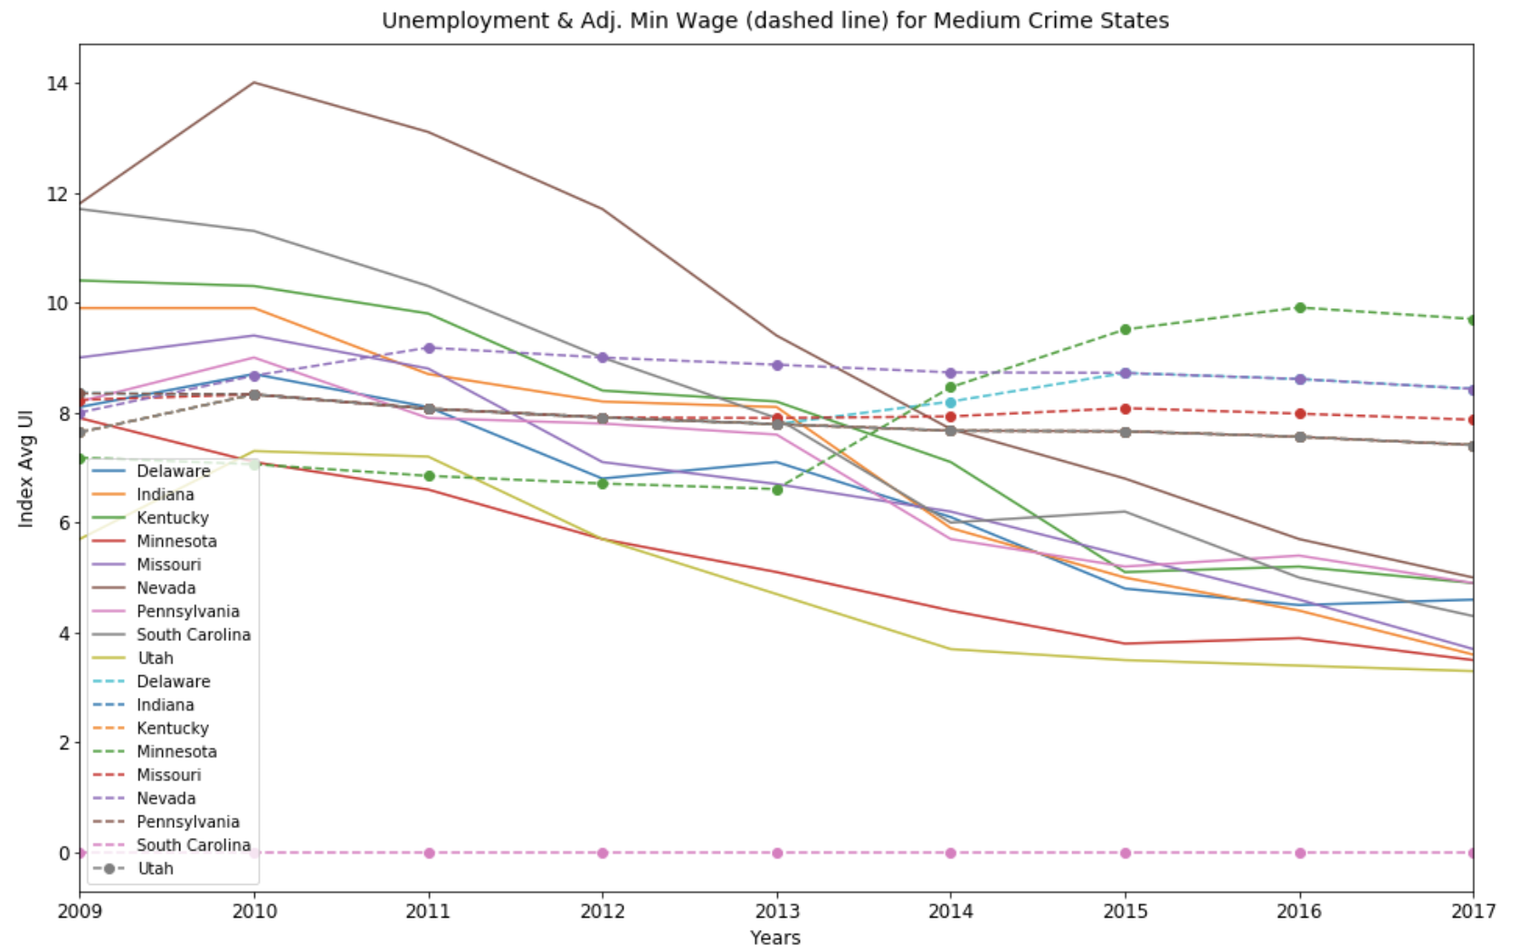
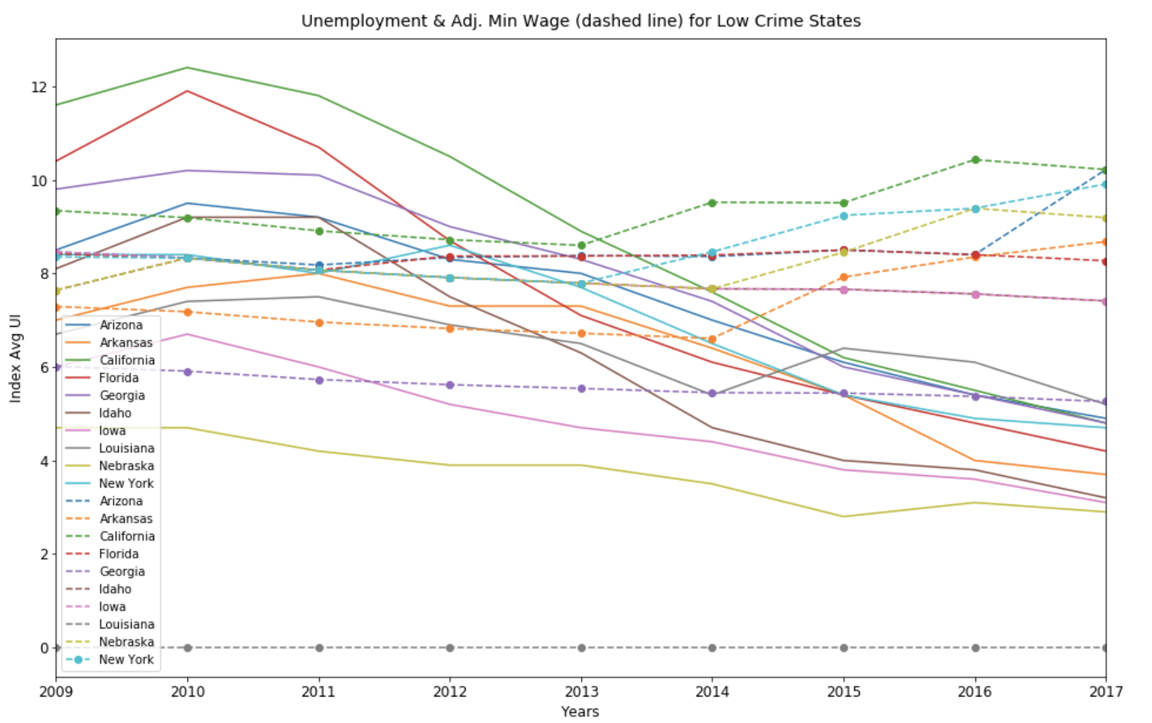
Grouped Data – By Crime Rates
States with historically high crime rates experience high drop in crime rates for small decreases in unemployment compared to states with more moderate and low levels of crime

Slide 16
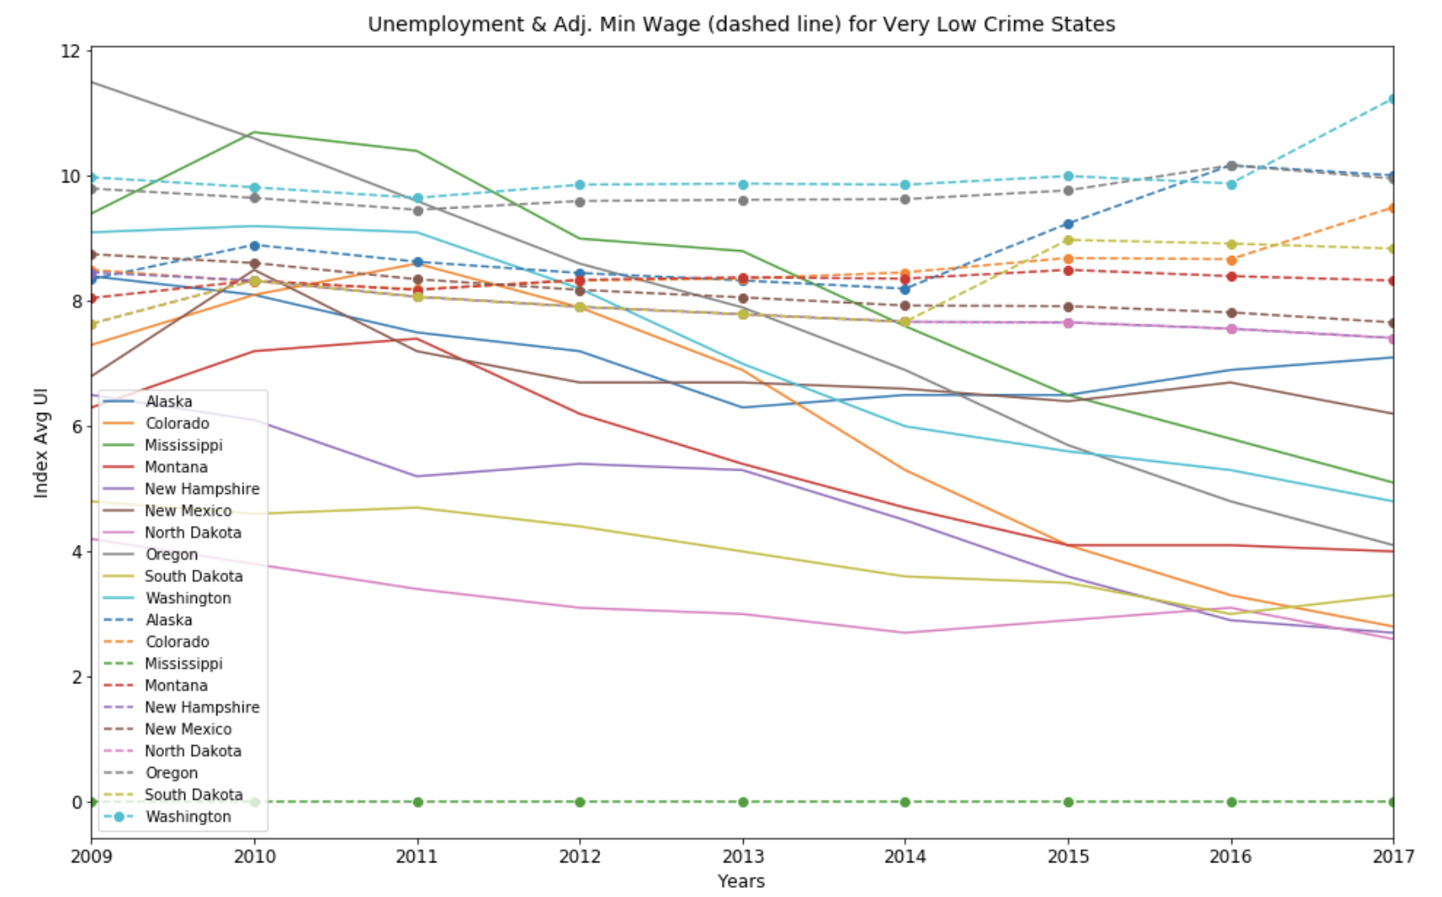
Grouped Data – Very Low Crime States
States which have historically experienced very low crime rates, the impact of decreased unemployment in crime is minimal and almost unnoticed.
These states also do not have a change in minimum wage for the years under study.

Slide 17
Discussion
One of our initial hypotheses was that because of increased unemployment, crime rates will also go up over time
After analyzing our data, we determined that indeed crime rate and unemployment move in the same direction consistently where as unemployment decreases crime rates also decrease.
However, we don’t have enough supporting evidence to establish causality. We would reframe the hypothesis to emphasize that though there is a positive relationship between the two, crime is not necessarily depended upon or determined by unemployment
In states with historically high crime rates, the effect of decreased unemployment on crime is much more noticeable than in states with lower crime
Minimum wage did not change drastically in the selected time period however, unemployment decreased drastically which had a positive impact on CPI
Our findings are heavily impacted by the recessions and post recession dynamics of the selected time-period

Slide 18
Post Mortem
A challenges we faced was in formatting the data and making it ready for merging (creating the final data set)
We focused on finding single year data per category– Crime, Unemployment, Minimum Wage
We cleaned each year individually and formatted it the same way for each year
We then stacked each year per group (Crime, Unemployment, Minimum Wage) to create three large data-sources for the same time period
Finally, we merged the data together to create one final large dataset to be used for exploration and analysis

Slide 19
Post Mortem
Our data was focused on the period between the height of the Great Recession and immediately after it. Some of our findings may be biased as a result of that. Several things will be interesting to explore further:
Would our results remain consistent if we were to expand our time frame to include data before, during, and after a major recession?
Do economic recessions and the unemployment generated as a result of them have a vastly different impact on crime compared to the unemployment during stable economic conditions?
How do our findings compare to similar economic conditions that happened in the past? Specifically, if we were to explore crime and unemployment around the 30s and 40s (during the Great Depression), would our findings be similar to what we observed during and immediately after the great recession?

